Slide 1
Preferential Attachment
Barabasi & Albert (1999): Emergence of Scaling in Random Networks, Science
Edros-Renyi (ER) random graph
  Probability 2 vertices connected is random and uniform
  Constant degree
  Low clustering
  Poisson distribution
    Probability of vertices with large k decreases exponentially with k
  Fixed N
Watts-Stogatz (WS)
  lattice with clustering
  random rewiring
  constant degree
  Fixed N
  Poisson Distribution

Slide 2
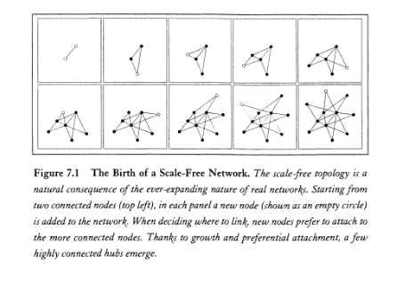
Preferential Attachment
Not fixed N: N varies over time
Probability two vertices are connected is not random and uniform

Slide 3
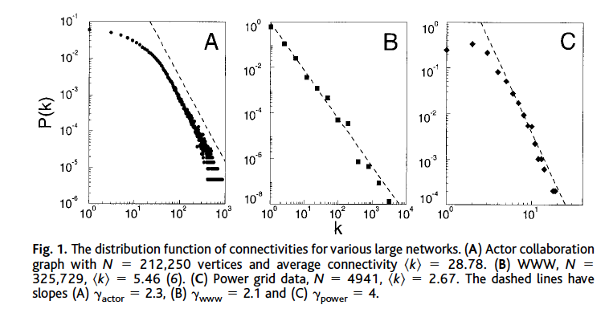
Preferential Attachment
Preferential Connectivity
  Probability a new vertex will connect to another vertex is a function of the degree of the other vertices
  P(k) ~ k ^{-y}

Slide 4
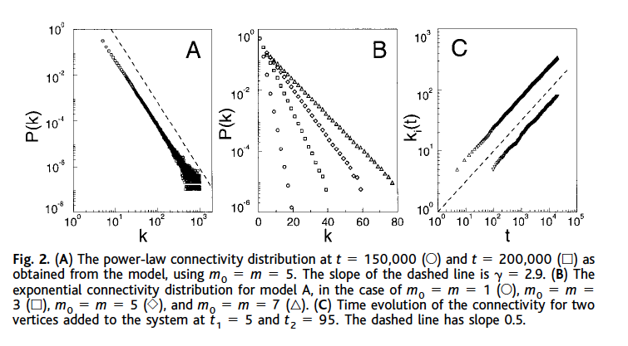
Properties of PA Model
Power-law degree distribution
  linear on log-log scale
  hubs
  y ~ 2.5 - 3.0
scale-free (invariance)
  percent increase in k --> percent increase in P(k)
  independent of t, m₀, and time added
  no mean (average, norm)
  self-organized scale-free stationary state
  SW?
Notes:
in and out degree??
out - URLs found on HTML doc
in - links that point to doc *****
adding edges vs adding nodes
reattachment

Slide 5
Gould 2002
Hierarchies (status inequalities) as emergent social process
  local actions (respect, liking, admiring)
  individual differences amplified
    via judgements of relative quality
  emergent social structure
Argument
  if no individual differences --> equality or total (winner-take-all) inequality
  If differences --> winner-take-all (star/hub)
  but social systems in between
  another social process -- reciprocity
    cost of liking A and not being liked by A

Slide 6

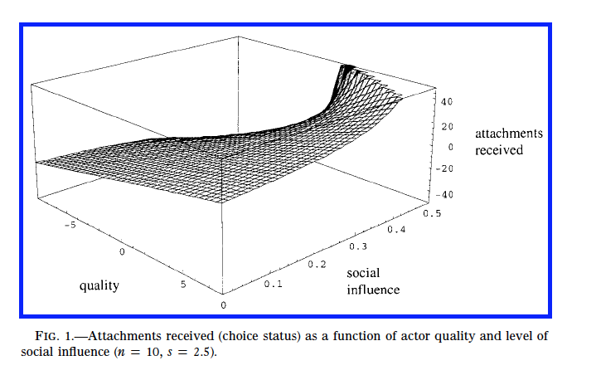
Amplification
(of individual differences)
Weighted social influence (w) amplifies perception of quality
"a substantial intensification of status inequality as the importance of social influence relative to exogenous quality increases" (p. 1158)

Slide 7
Tradeoff
Attached to desirable others (preferential attachment) --> amplification & inequality
attach to available others (reciprocity)
tolerance for asymmetry (s parameter)
  if painful --> attach to available others
    slows amplification process
  if not painful --> attach to desirable others
    acceptance of status inferiority

Slide 8
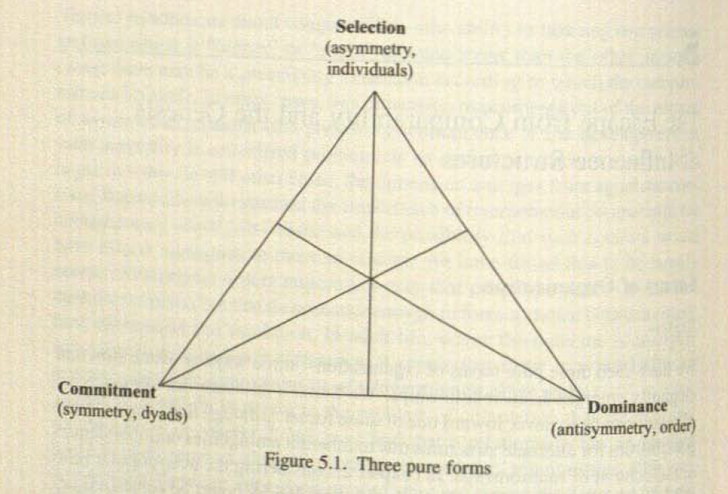
Martin: Social Influence (Chapter 5)
Selection
  preferential attachment
  popularity tournament
Commitment
  e.g. marriage
  reciprocity
Dominance
  transitivity
  pecking order
  social influence
PA is not dominance

Slide 9
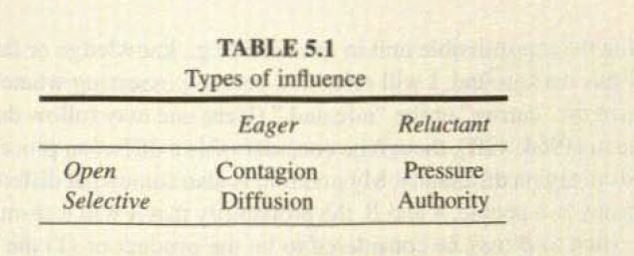
Types of Influence
Contagion: not specific, no resistance
  Traditional "infection" model
  S shape curve
Pressure: not specific, resistance
  threshold model: resist until enough others "infect" you
  critical mass
Diffusion: specific, no resistance
  p-differential: probability of contact
  but whatever increases probability of contact could be the cause of similarity
  spurious diffusion
  asymmetry --> q-differential

Slide 10
Authority
q-differential: probability of transmission
credibility vs. authority
  credibility --> mutuality, cliques
  authority --> command trees

Slide 11
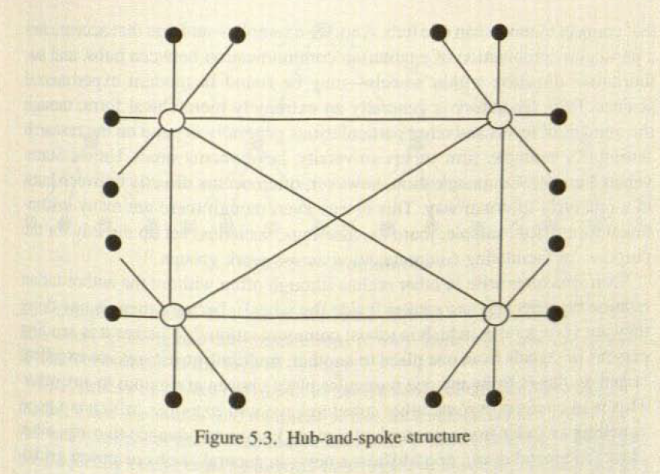
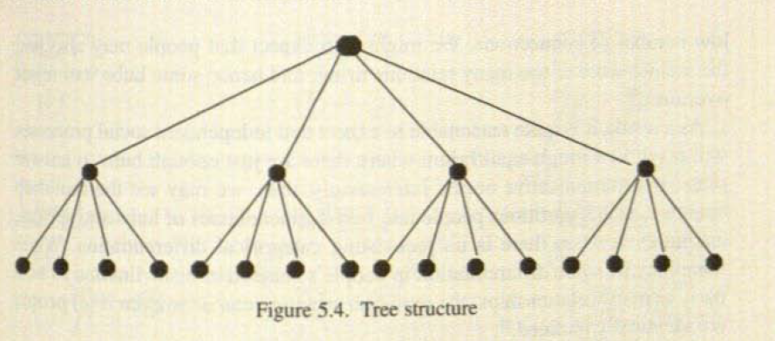
Hierarchy Forms
q-differential - credibility --> cliques
  in-group / out-group
PA --> status hierarchy, amplification, deference
  core-periphery
  random seed diffusion
q-differential - authority --> command trees
  specific starting place diffusion
  pecking order (caged system) ?? emergent??
  always accept influence from those higher in status

Slide 12
Trisets
Never accept influence from someone lower than you
  all arrows go down
  can reject influence
Tendency not to directly influence someone who is far below you (mediation)
Multiple influencers

Slide 13
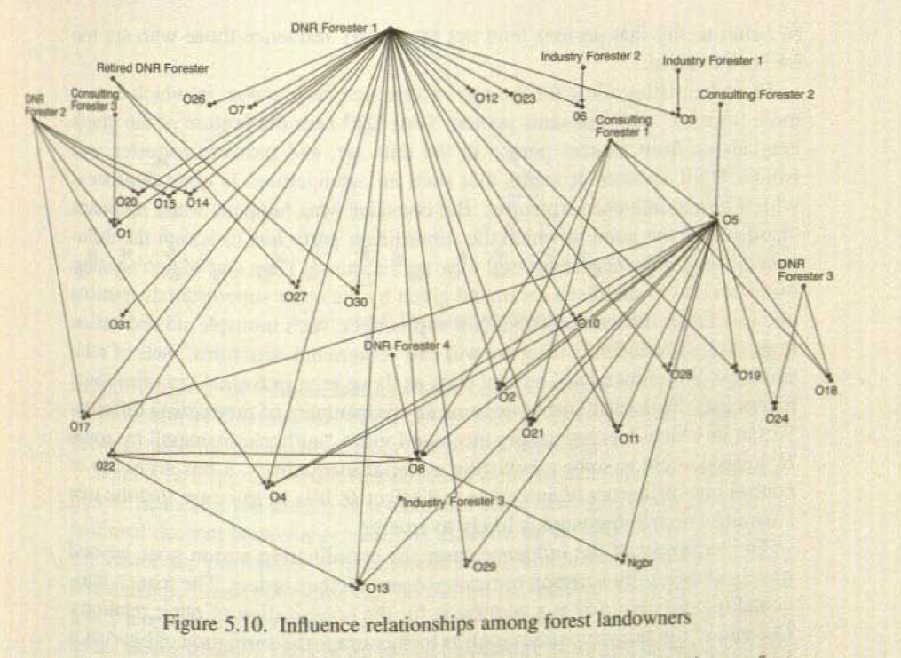

Slide 14
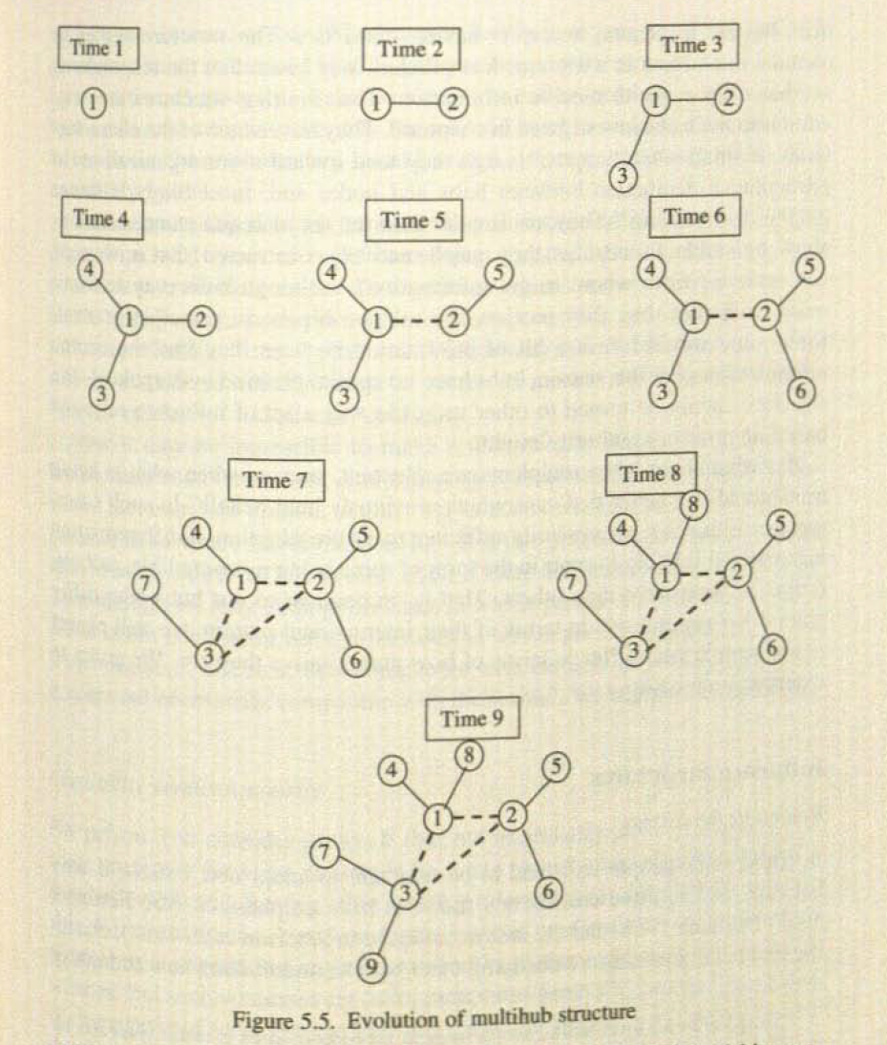
Evolution of Core-Periphery Structure

